Slide 1
CMM560 Topic 9 - GPT

Slide 2
Content
(Vanilla) CNN is just the start!
P: Pre-Trained Models → Transfer Learning
G: Generative Models
T: Transformers!

Slide 3
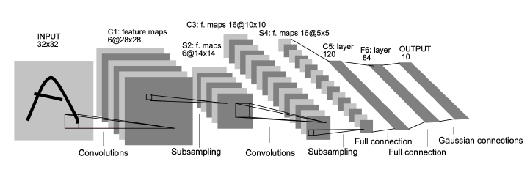
(Vanilla) CNN is just the start!
The network we saw last week is often called “LeNet” or “Vanilla-CNN”
It was “tailor-made” to solve the MNIST problem, although it could solve many more!
The biggest drawback is that the filters used are too simple to tackle other challenges!
______________________________________________________________
Y. LeCun et al., “Gradient-based learning applied to document recognition”. Proceedings of the IEEE, vol. 86, no. 11, pp. 2278-2324, 1998, doi: https://doi.org/10.1109/5.726791

Slide 4
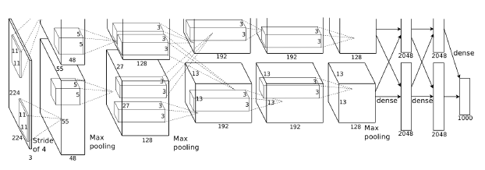
AlexNet
Won the 2012 ImageNet ILSVRC challenge (by a large margin).
Achieved top error rate of 17% (second best achieved only 26%)
It is much larger and deeper than LeNet, and the authors used dropout and data augmentation to reduce overfitting
It was the first network trained in a GPU, thanks to Krizhevsky’s gaming expertise!
______________________________________________________________
A. Krizhevsky et al., “ImageNet classification with deep convolutional neural networks”. Proceedings of the 25th International Conference on Neural Information Processing Systems (NIPS) 2012, doi: https://dl.acm.org/doi/10.5555/2999134.2999257
Notes:
ImageNet Large Scale Visual Recognition Challenge (ILSVRC) from Stanford
5 conv and 3 fcn

Slide 5
GoogLeNet
Won the ILSVRC challenge in 2014, developed by Szegedy et al.
Much deeper network than previous CNNs (one early version is made of 22 conv layers!)
Several extensions of GoogLeNet were developed later by Google researchers, most notably the Inception architectures
Allow the network to choose between multiple convolutional filter sizes in each block.
An Inception network stacks these modules on top of each other, with occasional max-pooling layers with stride 2 to halve the resolution of the grid
______________________________________________________________
C. Szegedy et al., “Going deeper with convolutions“. Proceedings of the IEEE Conference on Computer Vision and Pattern Recognition (CVPR), 2015, doi: https://doi.org/10.1109/CVPR.2015.7298594

Slide 6
GoogLeNet
https://paperswithcode.com/method/googlenet

Slide 7
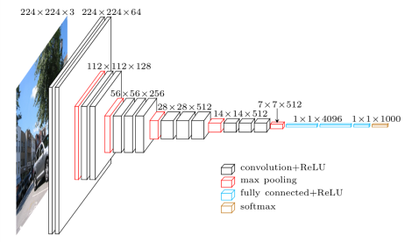
Visual Geometry Group (VGG)
Very deep architecture of 16 or 19 layers in total
Designed to have 2 or 3 conv layers, and a pooling layer, then again 2 or 3 conv layers followed by a pooling layers to reach 16 layers (in VGGNet16) and 19 layers (in VGGNet19)
Used for multiple object detection.
______________________________________________________________
K. Simonyan and A. Zisserman, “Very Deep Convolutional Networks for Large-Scale Image Recognition”. International Conference on Learning Representations (ICLR) 2015, doi: https://arxiv.org/abs/1409.1556
Notes:
You can compete against Google!

Slide 8
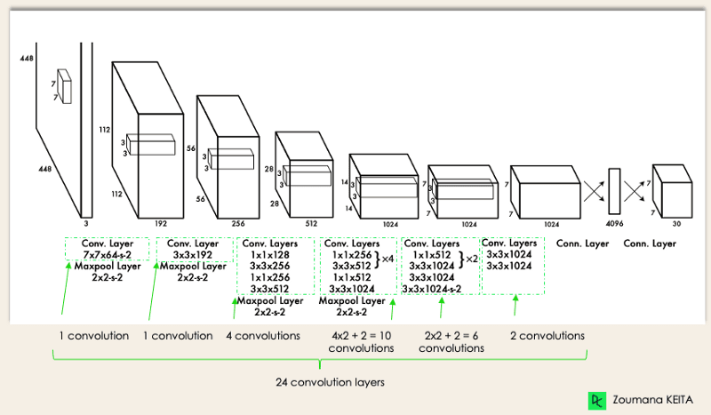
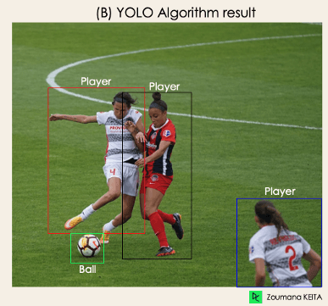
You Only Look Once (YOLO)
https://www.datacamp.com/blog/yolo-object-detection-explained
One of the most popular architectures in recent times
Authors framed object detection as a regression rather than a classification problem by spatially separating bounding boxes and associating probabilities to each of the detected images using a single CNN
Architecture similar to GoogLeNet
24 convs. 4 max pool, 2 FCN
Advantages: Speed, accuracy, generalisation, open source
______________________________________________________________
Redmond et al. , “You Only Look Once: Unified, Real-Time Object Detection”. ArXiV 2015, doi: https://arxiv.org/abs/1506.02640

Slide 9
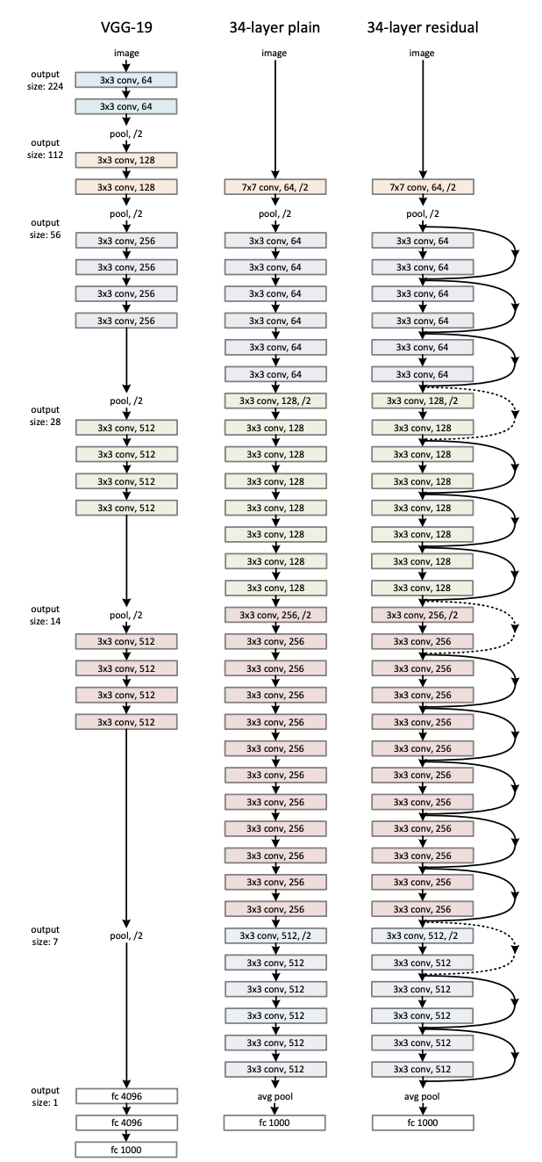

ResNet
https://paperswithcode.com/method/resnet
Training very deep networks proved to be problematic and can cause problems such as vanishing/exploding gradients
However, ResNet made it possible to train a very deep network without harming the performance
Residual: Learning from a reference rather than the direct output
______________________________________________________________
He et al. , “Deep Residual Learning for Image Recognition”. Proceedings of the IEEE Conference on Computer Vision and Pattern Recognition (CVPR) 2016, doi: https://arxiv.org/pdf/1512.03385.pdf
Notes:
The vanishing gradient problem is a phenomenon that occurs during the training of deep neural networks, where the gradients that are used to update the network become extremely small or "vanish" as they are backpropagated from the output layers to the earlier layers.
152 layers, yet the authors managed to train such a deep network using the skip connection (instead of feeding directly into the next layer, some signals are fed to layers higher up in the stack of layers)

Slide 10
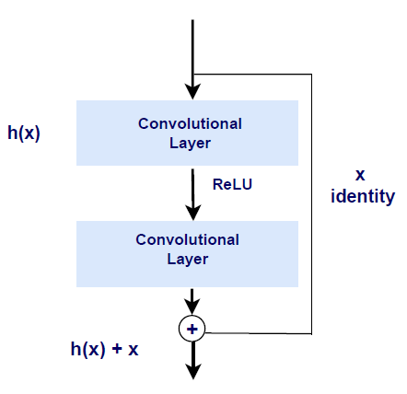

ResNet
Recall that the target of training is to model a function h(x), and so if you add input x to the output of the network (add a skip connection), then the network will end up modelling f(x) = h(x) - x instead of h(x)
This is called residual learning
At the start of the training, the weights are initialized to be close to zero, so the network will simply output values close to zero.
When adding the skip connection, the network will end up outputting a copy of its inputs.
This simply means if the target function is close to the identity function (often the case)
This will speed up the training process and the network can start making progress even if some layers haven't started learning yet.

Slide 11
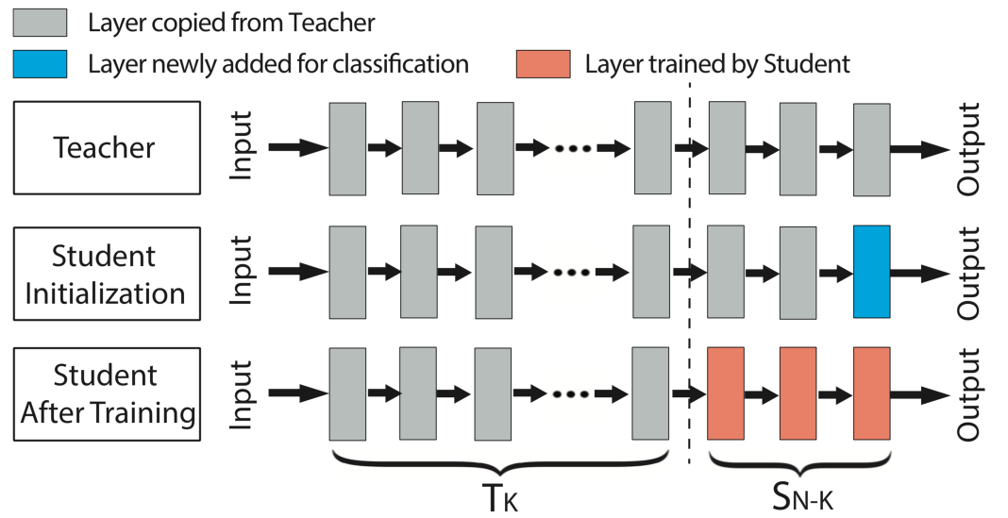
Pre-Trained Models → Transfer Learning
(Almost) nobody implements these modules from scratch
Use pre-trained models with a single line of code!
Most have been trained on large volumes of data (e.g. ImageNet which has 1 million images)
Therefore, they “know” how to recognise the most basic objects (e.g. people, vehicles, animals)
We “freeze” the lower layers and train the higher ones (fine-tuning).
Obviously, you also need to change the output layer (to predict your labels)
As a result, you need less training data to achieve better results
https://bdtechtalks.com/2019/06/10/what-is-transfer-learning/

Slide 12
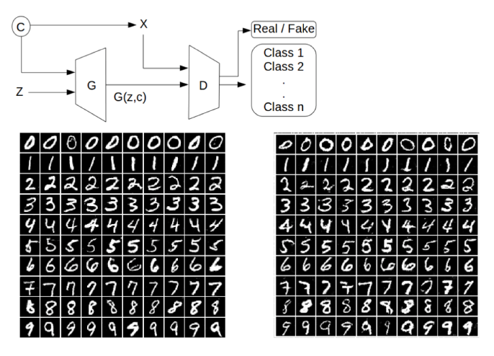
Generative Models
While the previous models classify/detect data better, attempts were made to make them generate data in parallel
Goodfellow et al. realised that if you train two DNNs to compete against each other, not only they can classify better, but also, they can generate images better!
One model is called the generator, and the other one is the discriminator
The generator tries to create simples close to the original, and the discriminator tries to identify real from fake
Gradually, the generator will improve and beat the discriminator (and possibly you!)
______________________________________________________________
Goodfellow et al. , “Generative Adversarial Nets”. Proceedings of the 27th International Conference on Neural Information Processing Systems (NIPS) 2014, doi: https://doi.org/10.48550/arXiv.1406.2661

Slide 13
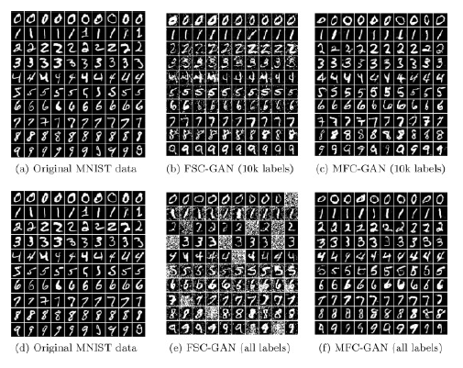
Generative Models
At the moment, there are more than 1000 different GANs!
https://github.com/hindupuravinash/the-gan-zoo

Slide 14
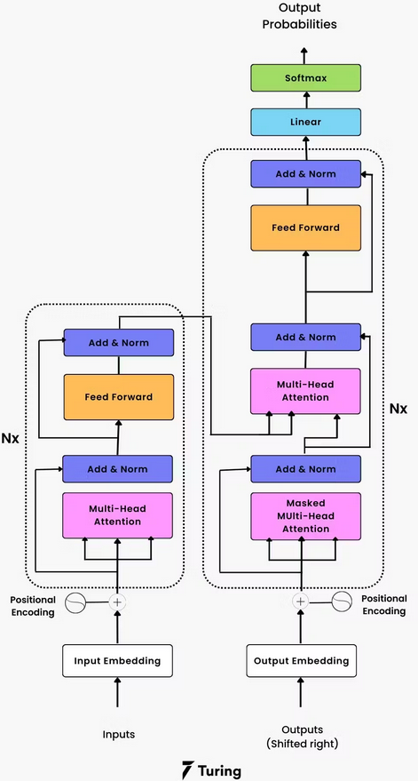
Transformers
https://colah.github.io/posts/2015-08-Understanding-LSTMs/
https://www.turing.com/kb/brief-introduction-to-transformers-and-their-power
There were previous attempts at understanding sequential data and adding “memory” to NNs
Examples include Recurrent Neural Networks (RNNs) and Long-Short Term Memory (LSTM)
However, in 2017, Vaswani et al. cracked a way to not only understand sequential data, but also to introduce “attention” mechanisms!
In fact, it is based on RNN, but it is not sequential!
Encoder & Decoder using embedded text data
______________________________________________________________
Vaswani et al. , “Attention is all you need”. Proceedings of the 31st International Conference on Neural Information Processing Systems (NIPS) 2017, doi: https://doi.org/10.48550/arXiv.1706.03762
Notes:
In fact, LSTM much like ResNet aims to deal with the vanishing gradient problem, which in this case, creates long term dependencies

Slide 15
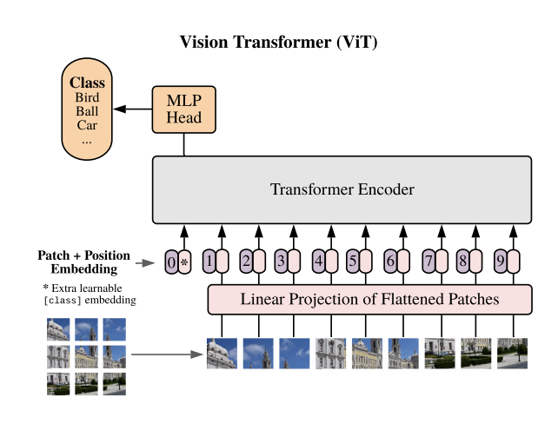
Vision Transformers (ViT)
Dosovitskiy et al. “borrowed” this idea and implemented it for images!
The method works very well, but it has high computational demand
Currently, they are the closest competitor vs CNN based architectures
Although you could “freeze” layers from a CNN and use their output to train a ViT instead of 16x16 patches!
Most likely to be used for action recognition
They can recognise “complex” actions
______________________________________________________________
Dosovitskiy et al. , “An image is worth 16x16 words: Transformers for Image Recognition at Scale”. Proceedings of the 9th International Conference on Learning Representations (ICLR) 2021, doi: https://doi.org/10.48550/arXiv.2010.11929

Slide 16
Other interesting models to explore
(Variational) Autoencoders
Feedforward networks to solve unsupervised learning
U-Net
The best option for medical image segmentation
Self-Organising Maps (SOMs)
PCA for images!
https://www.simplilearn.com/tutorials/deep-learning-tutorial/deep-learning-algorithm

Slide 17
Lab
Option 1: Transfer Learning
Option 2: Bayesian Classification using R

